Slide 1
Contributing to Kubernetes 101
Nikhita Raghunath and Divya Mohan

Slide 2
Instructions - https://github.com/kubernetes-sigs/contributor-playground/tree/master/remote/ghc-osd-2021

Slide 3
Our Experiences
Notes:
Owner: both
Timebox: 10mins
A brief on who we are along with a short walk through our experience getting started contributing to Kubernetes

Slide 4
Community
Notes:
Owner: Divya

Slide 5
What you should know
The K8s community is organized into subgroups as below:
Special Interest Groups, SIGs
Subprojects
Working Groups, WGs
Committees
User Groups

Slide 6
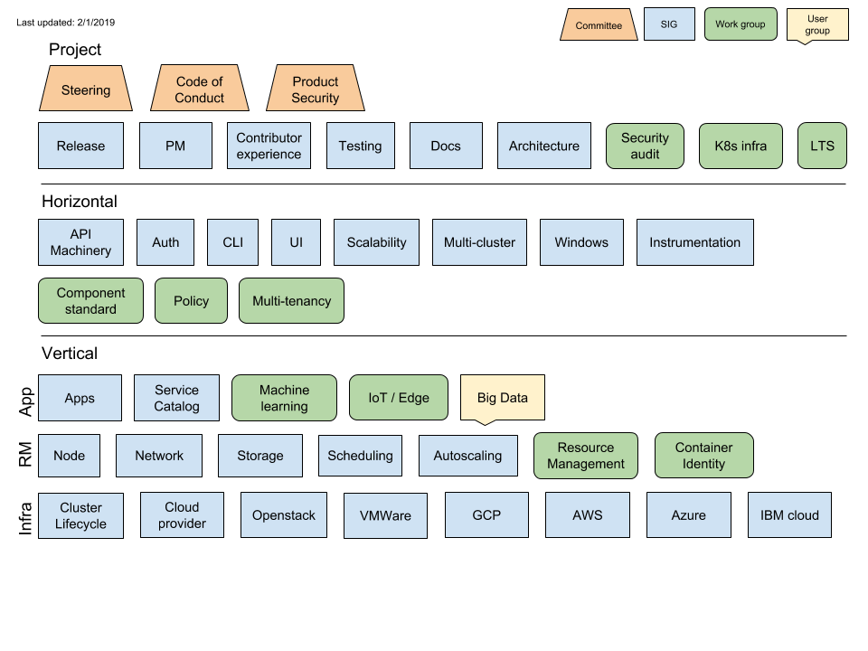
What you should know

Slide 7
Finding the right SIG
Picking the right SIG
Figure out what specific projects/areas you want to work on.
Find out which SIG/WG/subproject covers that
Ask on #sig-contribex
Go to the SIG intros at this conference
Join that SIG/subproject
If joining a WG/subproject, also join a SIG

Slide 8
How do I join a SIG?
How Do I Join A SIG?
Join the sig-specific mailing list. This is open to anyone.
That’s it. You’ve joined a SIG.
Notes:
Go to k/community
Navigate to sig-architecture
Scroll down to the README mailing list section
Click on the link
And then Click on Join

Slide 9
Communication
Notes:
[Divya]

Slide 10
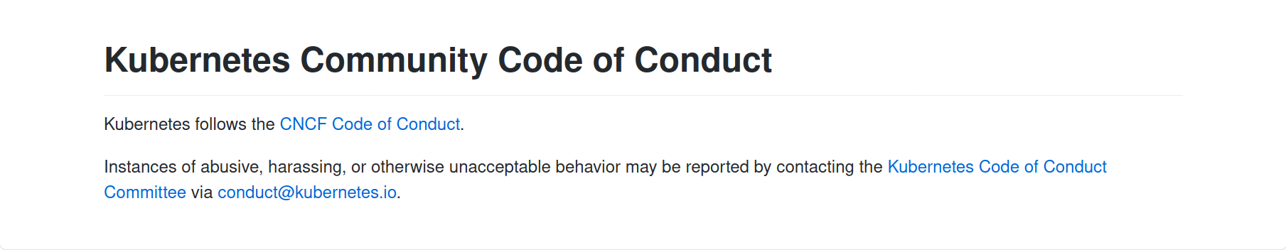
Before we get started

Slide 11
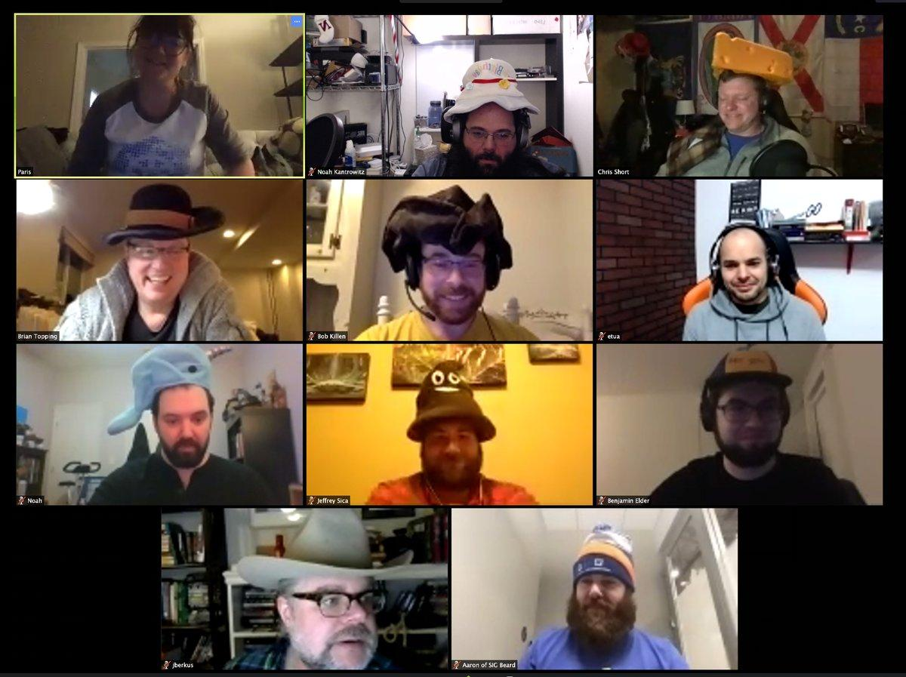
Meetings

Slide 12
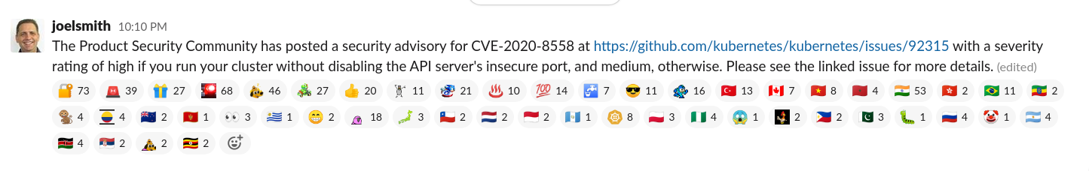
Slack - emojis!

Slide 13
Walkthrough of the Kubernetes codebase
Notes:
We’ve talked a lot about the how the Kubernetes community works, now let’s dive in to the codebase.

Slide 14
Core Repository
kubernetes/kubernetes
Most SIGs are stakeholders in the monolith.
Areas of SIG ownership can be found in https://git.k8s.io/community/sigs.yaml
Notes:
We are going to do a quick walkthrough of the main Kubernetes codebase. I will give an overview of how the code is structured overall but I will not be going into very specific details in the interest of time.

Slide 15
How to find your first issue?
Notes:
[nikhita] Let’s tackle another biggest question on everyone’s minds -- HOW do I find a task to work on?

Slide 16
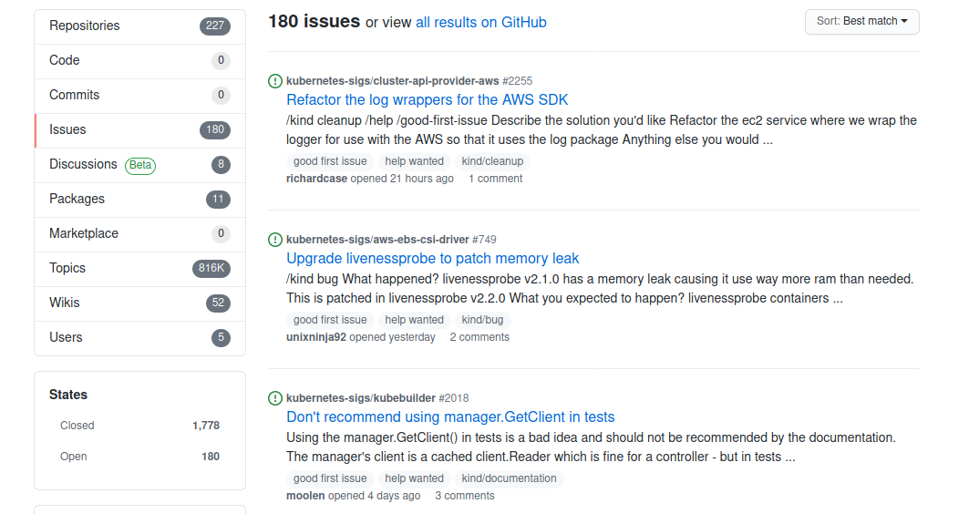
Good first issues
https://go.k8s.io/good-first-issue
Source: Bob Killen/Sahdev Zala on #sig-contribex
Notes:
Most open source projects surface a list of issues or tasks for beginners. Kubernetes does this too using a GitHub label called “good first issue”.
If you are just starting out in the project, you can go to the link go.k8s.io/good-first-issue.
These issues have no barrier to entry - as a new contributor, you should be able to tackle these without advanced setup or domain knowledge.
The solution, background knowledge, context and links to relevant code are also explained in the issue itself.
And the best part about these issues is that you get a dedicated mentor who will work with you to get your contribution merged.
I’d really recommend starting out with this because a LOT of the existing contributors jumped in this way.

Slide 17
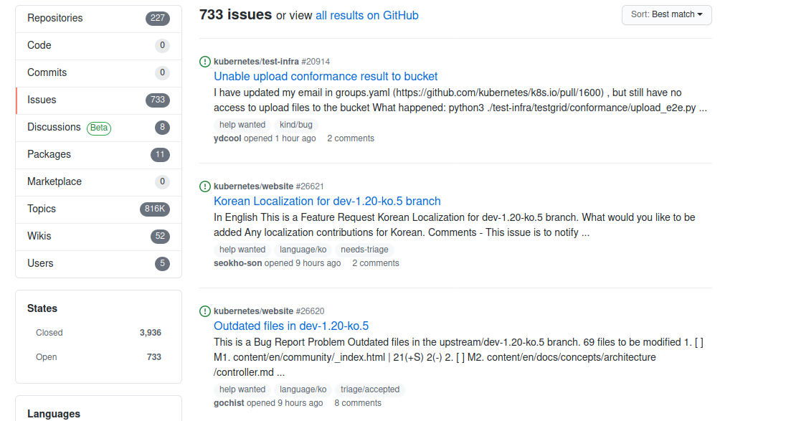
For the initiated
https://go.k8s.io/help-wanted
Source: Bob Killen/Sahdev Zala on #sig-contribex
Notes:
When you have solved a “good first issue”, you can take a look at another set of issues with the label “Help Wanted”.
These issues also have a low barrier to entry and kind of has a Goldilocks priority... so not too high that a core contributor would do it, but not too low that it isn't useful enough for a core contributor to spend time to review it, answer questions and help get it into a release. So these are also REALLY REALLY good places to jump in.

Slide 18
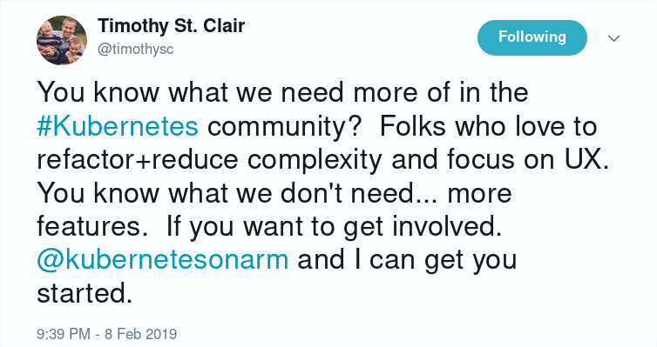
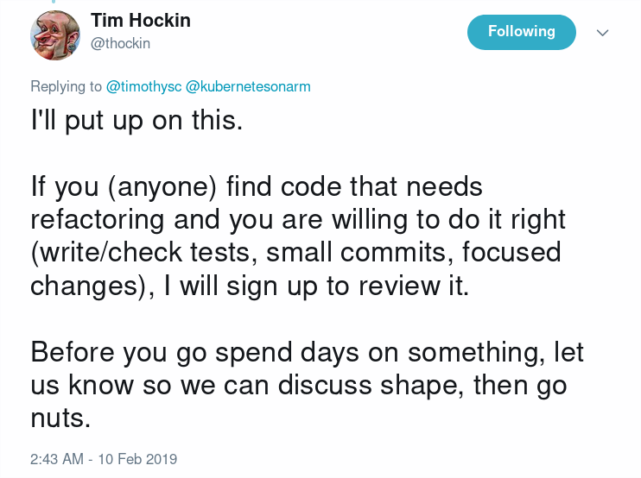
Refactor, document code, write tests and help fix test failures!
Notes:
Other slightly ad-hoc but more useful ways to jump in would be to refactor and document code, write tests and help fix test failures. I want to call this out explicitly because sometimes folks think that writing tests or fixing them is not really a “fancy” or “shiny” contribution.
However, Kubernetes is in a phase where we want to make it more stable. We don’t really want to add more features.
So honestly the project would love, ABSOLUTELY LOVE your contribution if you wrote tests or fixed them.

Slide 19
…. and a lot more ways
https://k8s.dev/docs/guide/non-code-contributions/
Notes:
Now, not all contributions have to be about code. In fact, I would actually go on to say that to keep a project like Kubernetes sustainable, you need a LARGE amount of contributions that have nothing to do with code at all.

Slide 20
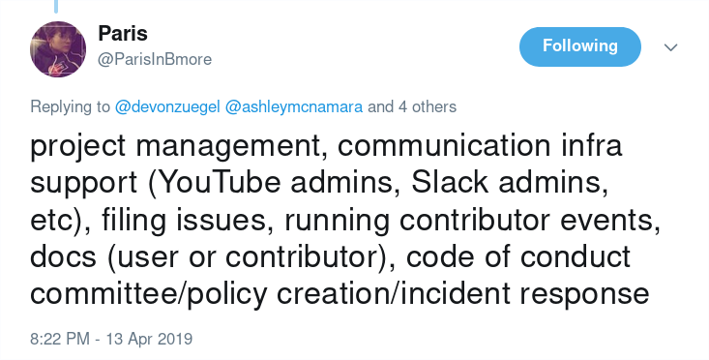
Notes:
Some examples of that include triaging issues, helping improve documentation and write blog posts.
There have been several folks who have been doing this consistently and have been promoted to lead positions in the community.
Because for good leadership, you need to care about the broader aspects of the project. Just writing code is not enough. And these type of contributions are a gateway to such lead positions.

Slide 21
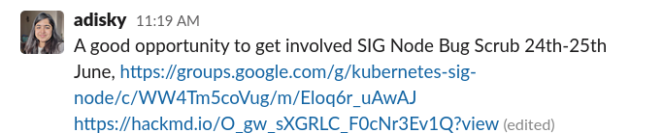
Notes:
SIG Node - the SIG that works on the kubelet and node is having regular Bug Scrub session. You can learn more about how we triage issues and if there are any issues that sound interesting to you, you can also volunteer to work on them in this session.

Slide 22
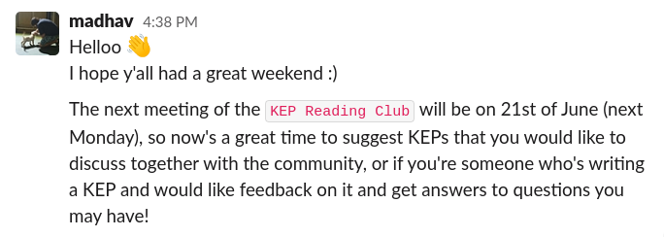
KEP Reading Club
Notes:
I want to introduce a new term real quick. A “KEP” in the Kubernetes project stands for “Kubernetes Enhancement Proposal”.
You don’t need to worry too much about these acronyms. A KEP is essentially a design proposal that needs to be written whenever a new feature gets added to Kubernetes. It’s a very detailed document. And we have started a new initiative called a “KEP Reading Club” similar to a “book reading club”. It’s a GREAT way to get more context and background on why a feature was written the way it was.
And understanding the history, the context will help you move quicker in your contributing journey.

Slide 23
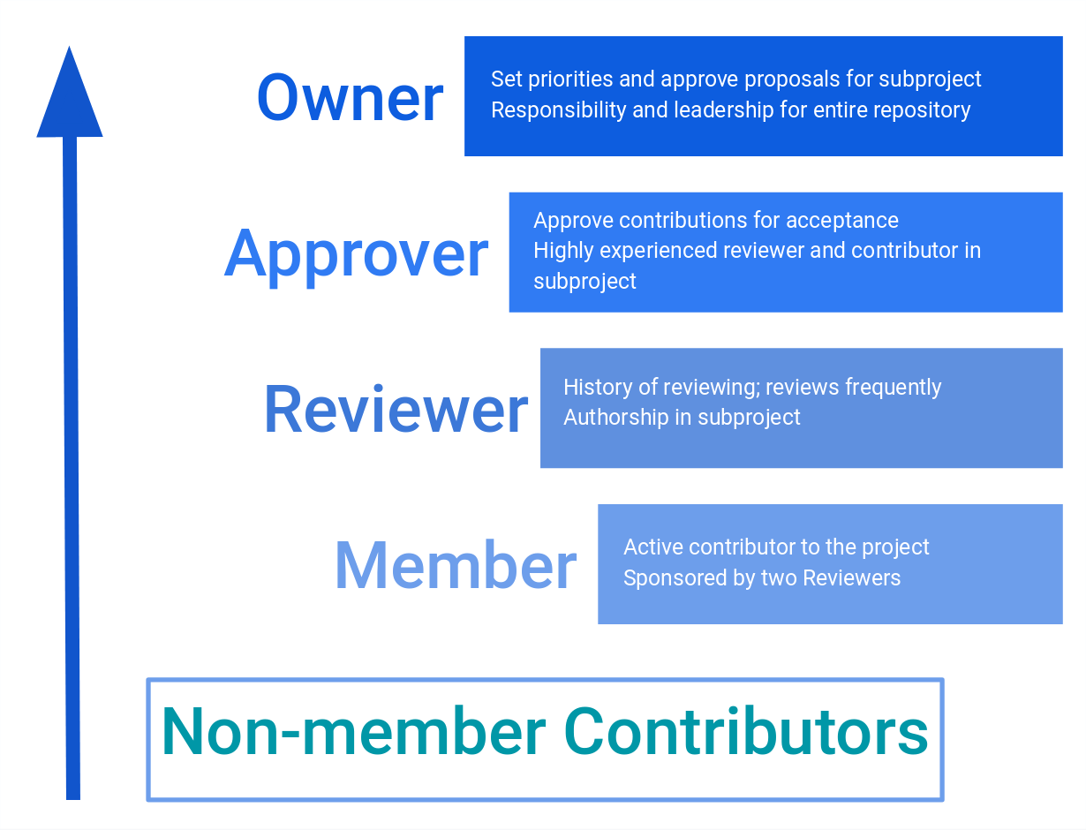
Getting involved
Notes:
Once you get started with contributing, you can move contributor ladder. First, you’d become a member of the Kubernetes GitHub organization. Then you’d become a reviewer who’d be reviewing code and an approver where you can sign off on PRs and eventually an owner who sets priorities and provides leadership for subprojects.

Slide 24

Notes:
And contributors also get this sweet Kubernetes patch. Fun fact about this patch is that it is sold for a 1000 dollars on the CNCF store so you can’t actually buy it. So you can contribute and get the 1000 dollars worth of patch for free!

Slide 25
Mentorship Programs
Notes:
[Divya] For those who would like mentorship, there also specific programs around this.

Slide 26
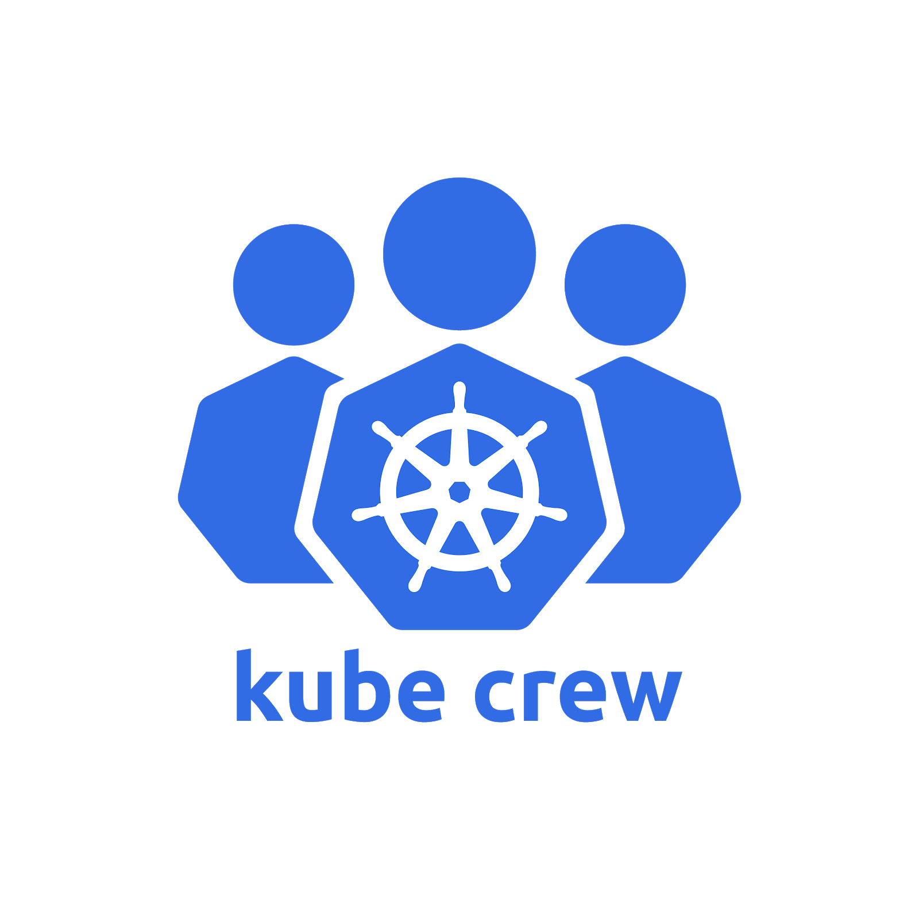
Mentorship Programs
Meet Our Contributors - #meet-our-contributors
Group Mentoring
Google Summer of Code
Outreachy
Linux Foundation LFX Mentorship Program
Notes:
Some examples are the popular Google Summer of Code for students, Outreachy and Linux Foundation’s LFX Mentorship Program. Most people think that these are usually for students only. That’s not the case. The LFX program is not just limited to students, ANYONE can apply.

Slide 27
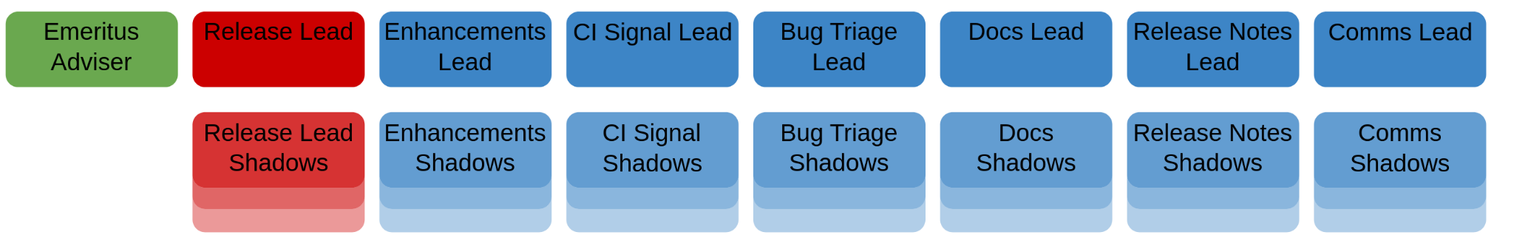
Kubernetes Release Team
Periodically releases a new version of Kubernetes
Collects features in a time frame and tracks whether the features go past the line
Ensures quality of the artefacts generated as part of the release
Image Source: https://git.k8s.io/sig-release/release-team/release-team.svg
Notes:
The Kubernetes Release Team is a subproject of the Special Interest Group Release. They are responsible for the day to day work required to successfully release while the SIG at large is focused on the continued improvement of the release process.
There are several verticals or focus areas in the release team. They handle one specific area of the release. For example, the enhancements team coordinates the features that will be released, CI Signal team continuously ensures that the quality of the release.
The Release Team follows a hierarchical team structure. An Overall Lead is designated for each Release along with a lead for each role. An emeritus advisor gets appointed from the previous release leads.
All of the lead roles select a set of 4-5 shadows ands mentors them for leading the role in a future release.

Slide 28
Hands-on session
Notes:
[nikhita]

Slide 29

Say Hi to the k8s-ci-robot!
Notes:
The k8s-ci-robot will be your BEST non-human friend throughout your journey in the Kubernetes community.
The bot is very friendly to talk to and gives you advice about your changes, whether they pass tests or not, who you would need to ask for reviews.

Slide 30
Bot commands
PRs and Bots: Useful Commands
Command
/assign @username
/retest
/close /cc @username
Result
Assigns a Reviewer
Reruns failed tests Closes PR Tags a user
Notes:
You can /assign someone to review your PR based on suggestions from the bot or someone who has volunteered to look at your code.
A lot of the common gh features, like closing a pull request, are disabled in favor of bot commands.

Slide 31


Slide 32
Contributor License Agreement
Contributions to the Kubernetes project require you to sign a CLA
Required to determine the legal status of contributions
There are two kinds of CLA:
Individual
Corporate
Note: Check in with your organization if you would need to sign the corporate CLA
https://git.k8s.io/community/CLA.md
Notes:
First, let’s talk some legal stuff.
Read the points impromptu
During this break I encourage you to sign the CLA as this would be needed when we get on to the hands-on before the end of the workshop.

Slide 33
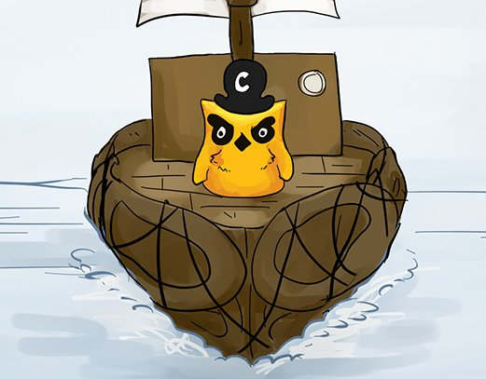
Welcome onboard!
Notes:
Welcome on board!
Today begins your journey on the good ship Kubernetes, as you crew with us in our voyage to build “the operating system of the cloud”. From today – if not earlier – you are not a passenger, but a member of the crew. A contributor who is helping make the next version of Kubernetes, and the next one after that.

